Slide 1
Getting the Point
John 5:39-47

Slide 2


Viola
Violin

Slide 3

The Scriptures,
above all,
lead us to

Slide 4
Perception
Picture someone who…
“KNOWS THEIR BIBLE”

Slide 5
ACADEMIC
Ivory Tower
Detached from
“real life”
DEBATER
Quotes Bible to make a case/prove
HATER
Quotes verses on sin to condemn others
RULE-FOLLOWER
“Goody-2-Shoes”
Boring, repressed

Slide 6
Distinction
Knowing the Bible
vs.
Understanding the Bible

Slide 7
ACADEMIC
Ivory Tower
Detached from
“real life”
“I’m smart”
DEBATER
Quotes Bible to make a case/prove
“I’m right”
HATER
Quotes verses on sin to condemn others
“I’m good”
RULE-FOLLOWER
“Goody-2-Shoes”
Boring, repressed
“I’m safe”

Slide 8

Direction
The Bible leads us to Jesus…
  John 5:39-40
  Luke 24:27, 44-45
  Matthew 5:7
  Luke 4:16-21

Slide 9
ACADEMIC
Ivory Tower
Detached from
“real life”
“I’m smart”
DEBATER
Quotes Bible to make a case/prove
“I’m right”
HATER
Quotes verses on sin to condemn others
“I’m good”
RULE-FOLLOWER
“Goody-2-Shoes”
Boring, repressed
“I’m safe”

Slide 10
Practical Tips
NO SHOE-HORNING!

Slide 11

Practical Tips
Story-Reading
Random
STORY

Slide 12
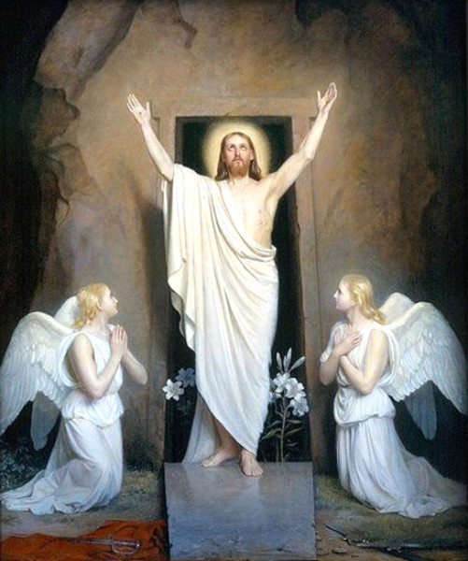
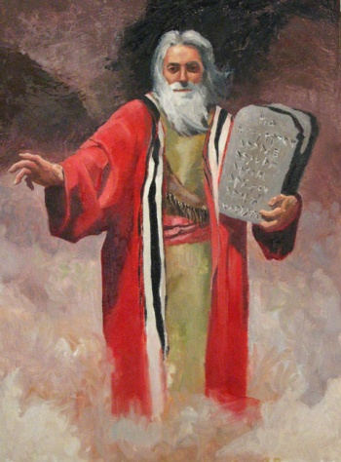
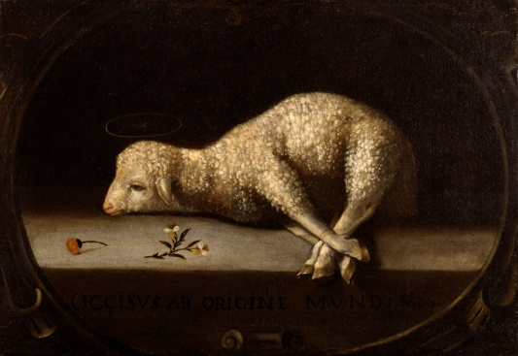
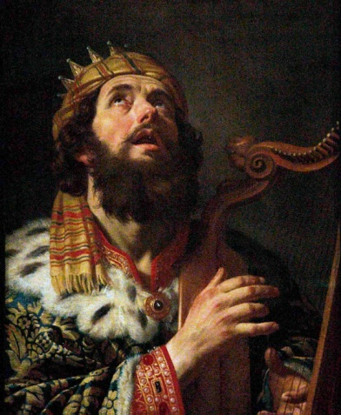
Practical Tips
Glimpsing
MOSES
LAMB
KING DAVID

Slide 13

Practical Tips
Needing

Slide 14
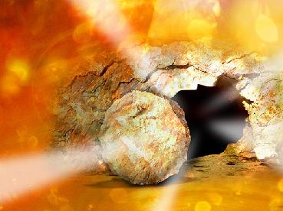
Practical Tips
Hoping

Slide 15
The Scriptures,
above all,
lead us to

